Slide 1
Graph Cuts....

Slide 2
Graphs from Images
A graph is a way to represent data with nodes (points) and edges (connections) between them. In this case, we are using the pixels of an image as nodes in the graph.
We consider a 4-neighborhood, which means that each pixel is connected to its immediate neighbors: the ones directly above, below, left, and right of it.
We also have two image regions, foreground and background. Each pixel belongs to either the foreground or the background region.

Slide 3
So, we create a graph where each pixel is a node, and we connect each pixel to its 4-neighborhood pixels. We label each node with its corresponding pixel value and whether it belongs to the foreground or background.
This graph can then be used for different purposes, such as image segmentation or object recognition, by analyzing the connections and relationships between the nodes.

Slide 4
Here’s how to build the graph:
Every pixel node has an incoming edge from the source node.
Every pixel node has an outgoing edge to the sink node.
Every pixel node has one incoming and one outgoing edge to each of its neighbors.

Slide 5
Bayes Classifier on the color values of the pixels. Given that we have trained a Bayes classifier on foreground and background pixels (from the same image or from other images), we can compute the probabilities p_{F} (I_{i}) and p_{B}(I_{i}) for the foreground and background. Here I_{i} is the color vector of pixel i.
To assign weights to the edges between pixels and between pixels and the source/sink, you need a model that can segment and determine the maximum flow allowed for each edge. The weight of the edge between two pixels is called “wij”. The weight from the source to a pixel is called “wsi” and from a pixel to the sink is called “wit".

Slide 6
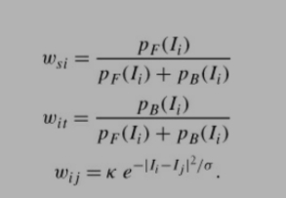
We can now create a model for the edge weights as follows:

Slide 7
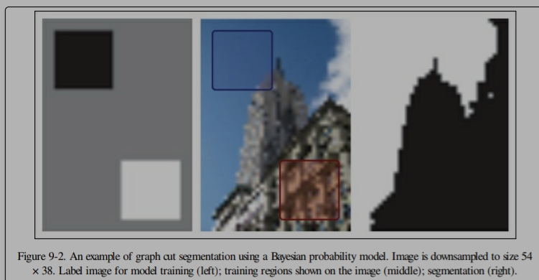

Slide 8
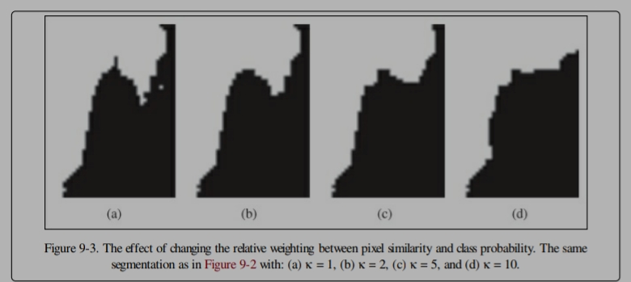

Slide 9
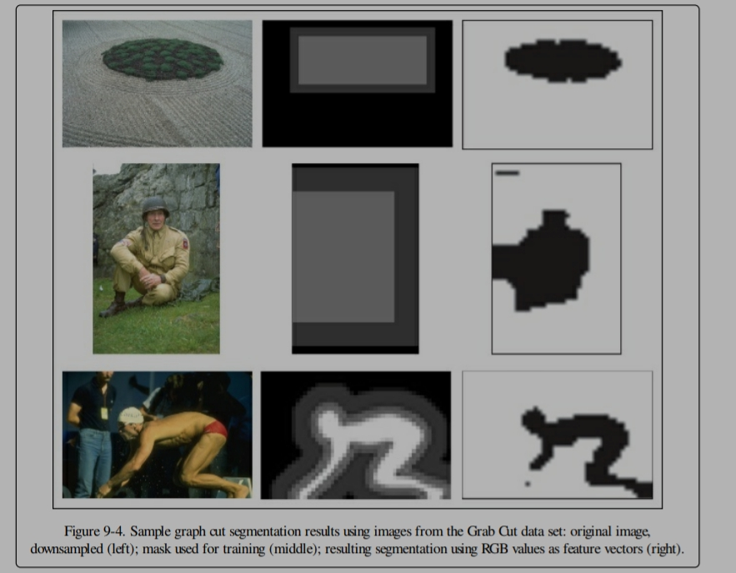

Slide 10
Segmentation By clustering:
The graph cut formulation in the previous section solves the segmentation problem by finding a discrete solution using max flow/min cut over an image graph.
Defining a cut cost that takes into account the size of the groups and “normalizes” the cost with the size of the partitions. The normalized cut formulation modifies the cut cost of equation

Slide 11

Where, A and B indicate the two sets of the cut and the sums add the weights from A and B, respectively, to all other nodes in the graph (which are pixels in the image in this case). This sum is called the association and for images where pixels have the same number of connections to other pixels, it is a rough measure of the size of the partitions.

Slide 12
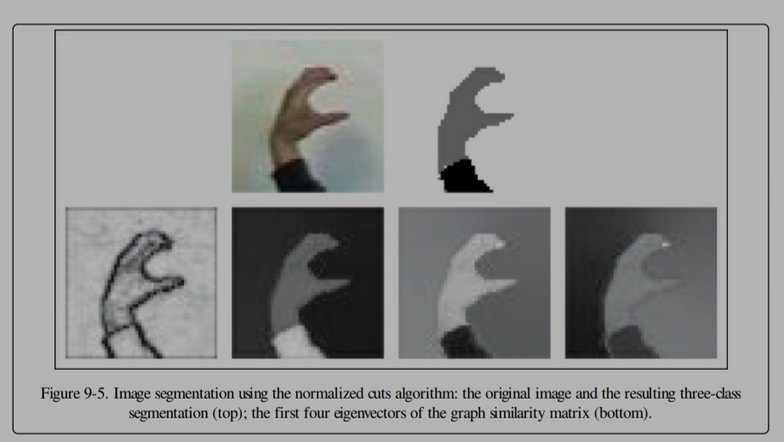

Slide 13
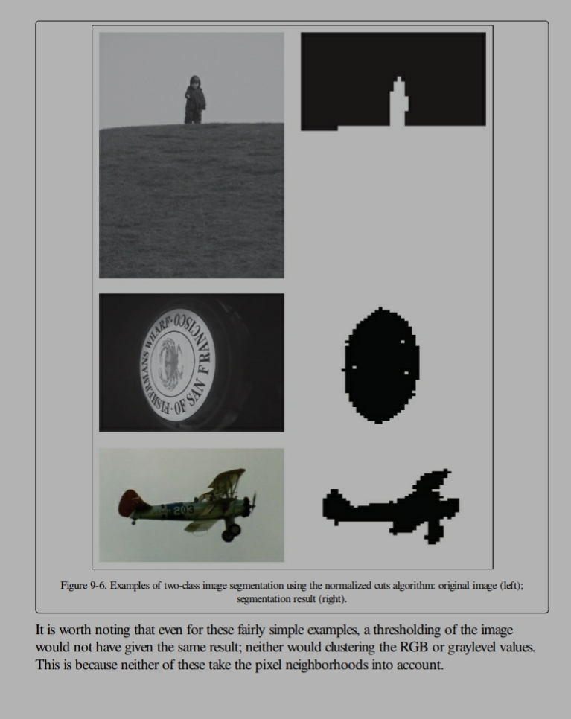

Slide 14
Variational Methods:
Variational methods are a popular class of optimization techniques used in image segmentation. Image segmentation is the process of dividing an image into multiple segments or regions, each with distinct visual properties. Image segmentation is a fundamental task in computer vision and is used in various applications such as object recognition, face detection, medical image analysis, and video surveillance.
Variational methods aim to find a segmentation that minimizes an energy functional consisting of two terms: a data fidelity term that measures the similarity between the image and the segmentation, and a regularization term that encourages the segmentation to have certain properties such as smoothness or compactness. The energy functional is typically formulated as a function of the segmentation variables and is minimized using optimization techniques such as gradient descent or conjugate gradient methods.

Slide 15
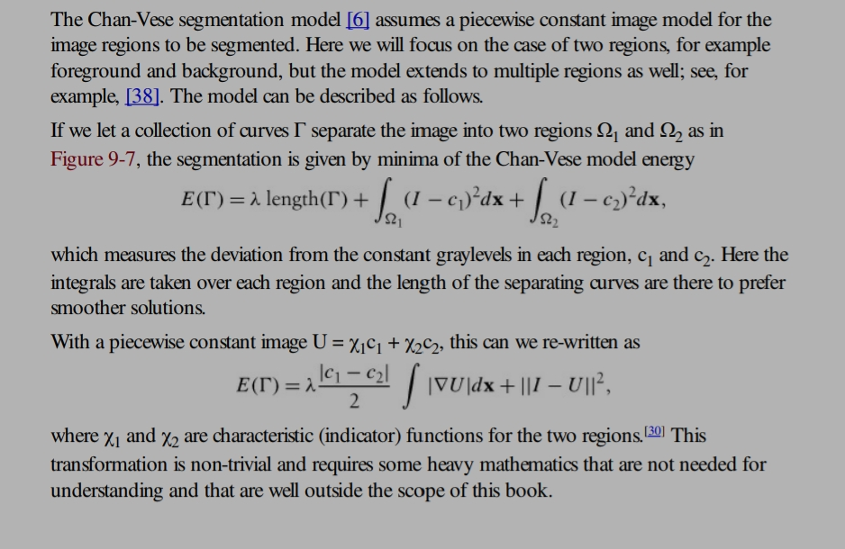

Slide 16
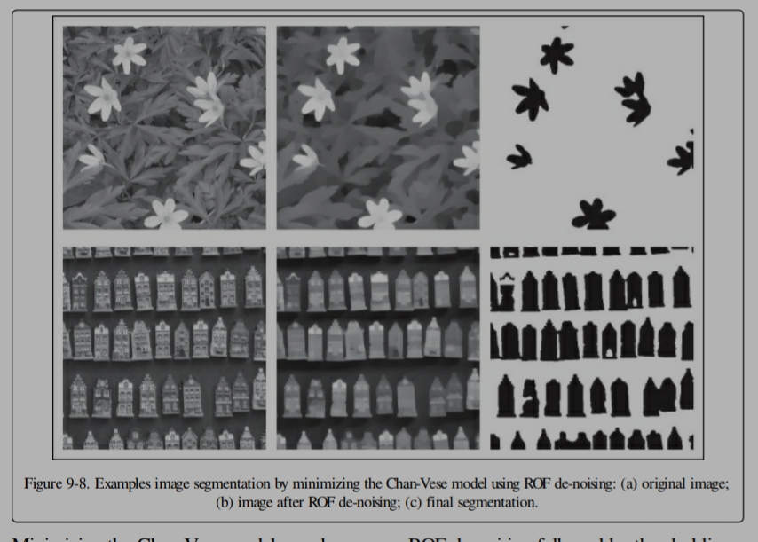

Slide 17
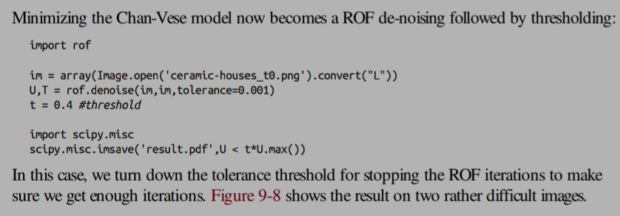

Slide 18
THANK YOU

